Slide 1


FOOD ORDERING WEBSITE A PROJECT FOR COURSE INTERNET PROGRAMMING LABORATORY(CSE 326)
SUBMITTED TO
MR.MUHAMMED RAFEEQ

Slide 2

MODULES:

Slide 3
ABOUT US:
A food ordering website is an online platform that allows users to browse, select, and purchase food items from various restaurants or food establishments. These websites serve as a convenient and efficient way for people to satisfy their cravings without leaving the comfort of their homes or offices.
User-Friendly Interface: The website typically has a clean and intuitive design to make navigation easy for users.
Menu Display: Menus are displayed with clear descriptions, prices, and images for each dish.
User Accounts: Users can create accounts to save their preferences, delivery addresses, and payment details for a streamlined ordering process.

Slide 4
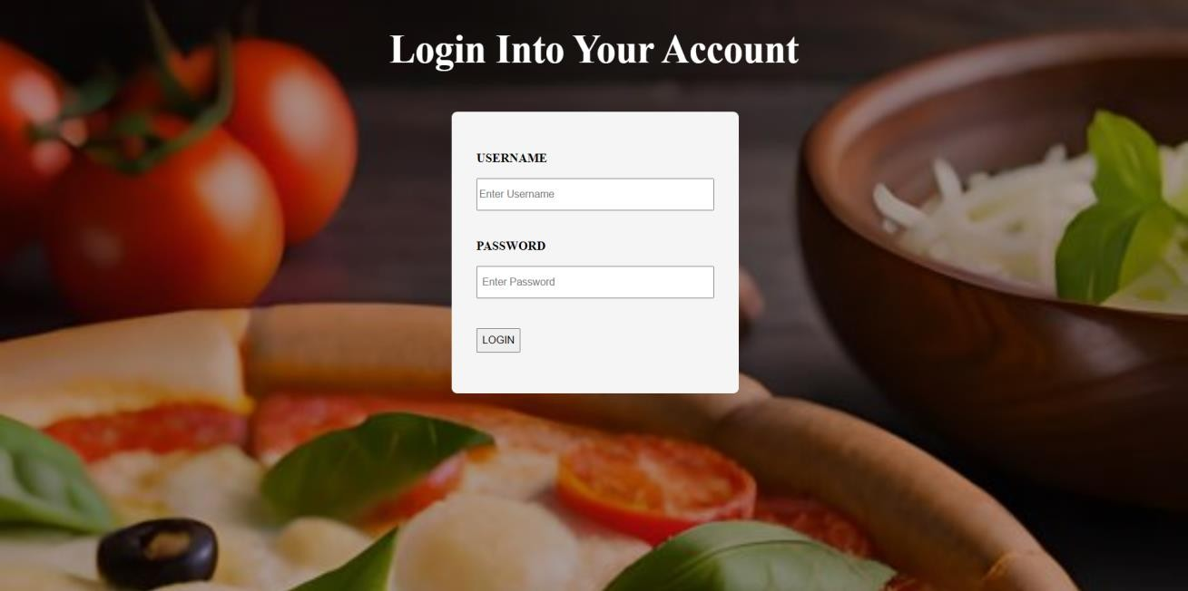
LOGIN PAGE:

Slide 5
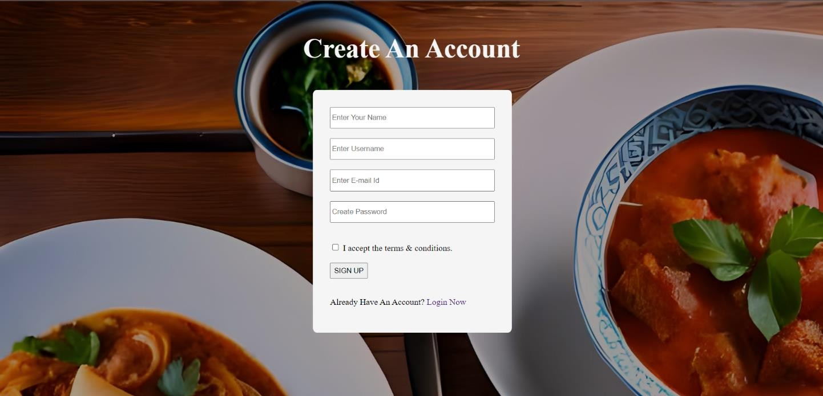
SIGNUP PAGE

Slide 6
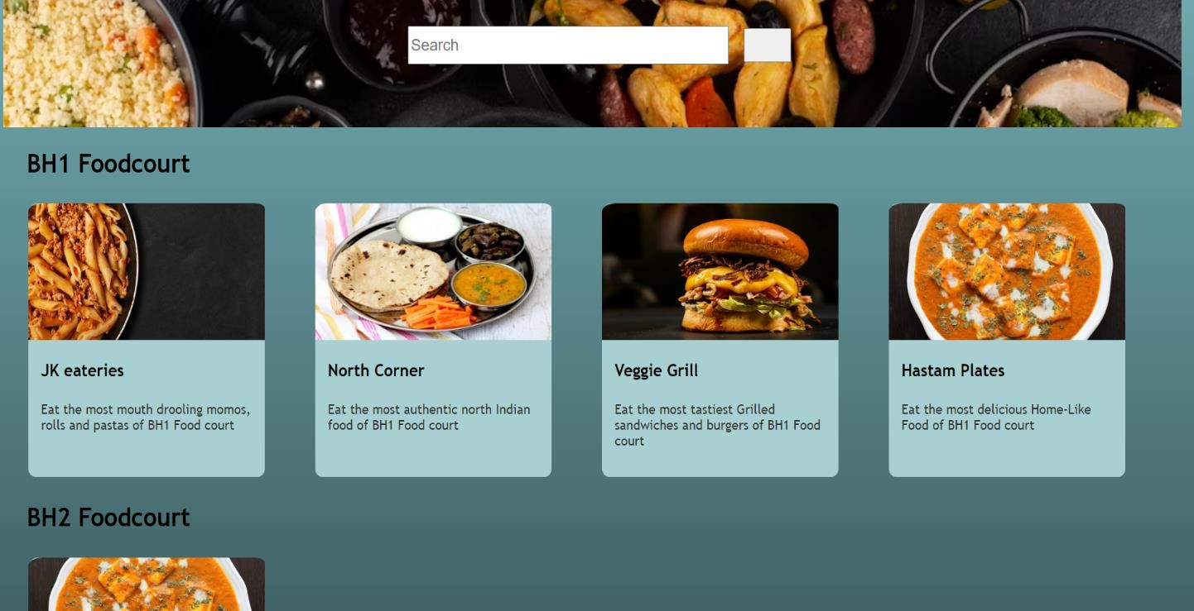
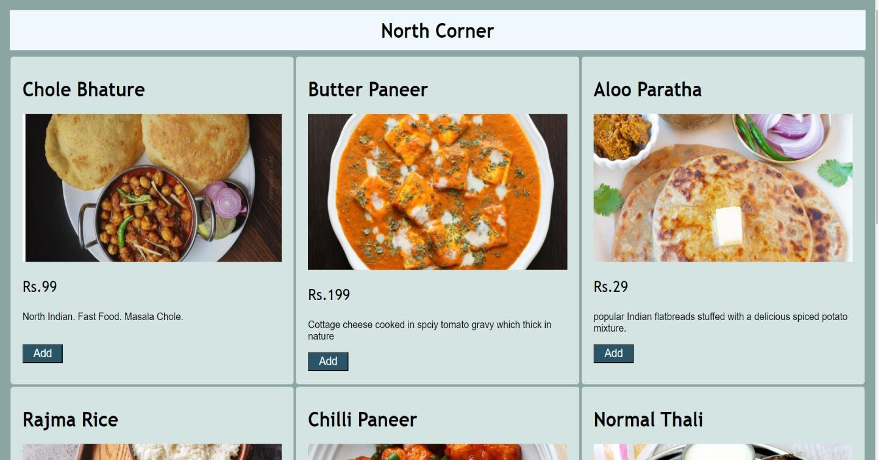
MENU

Slide 7
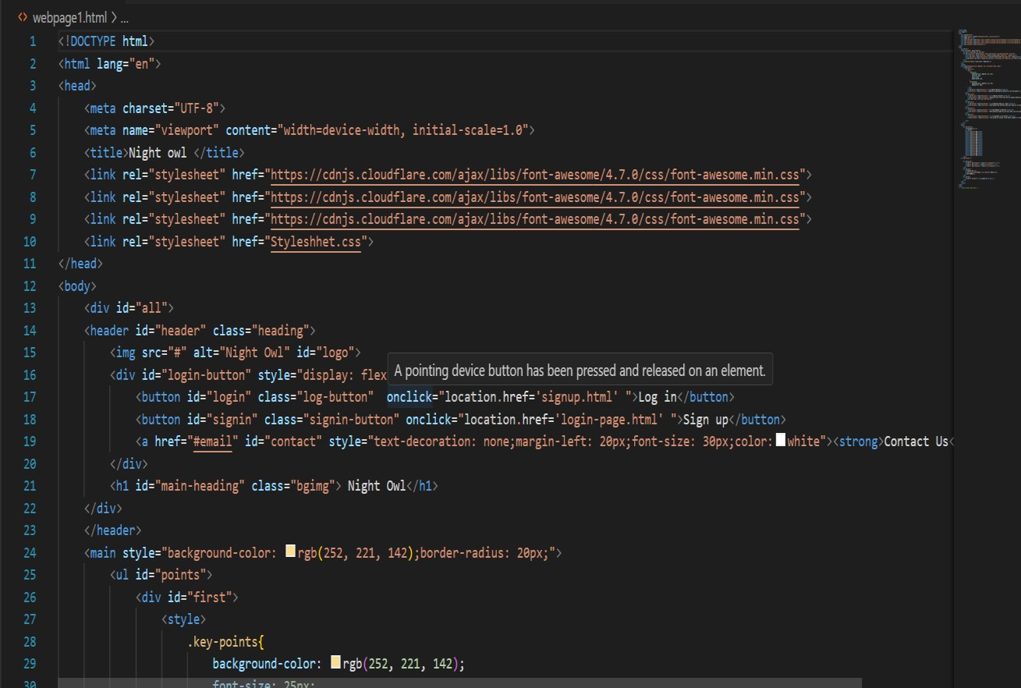
CODES

Slide 8
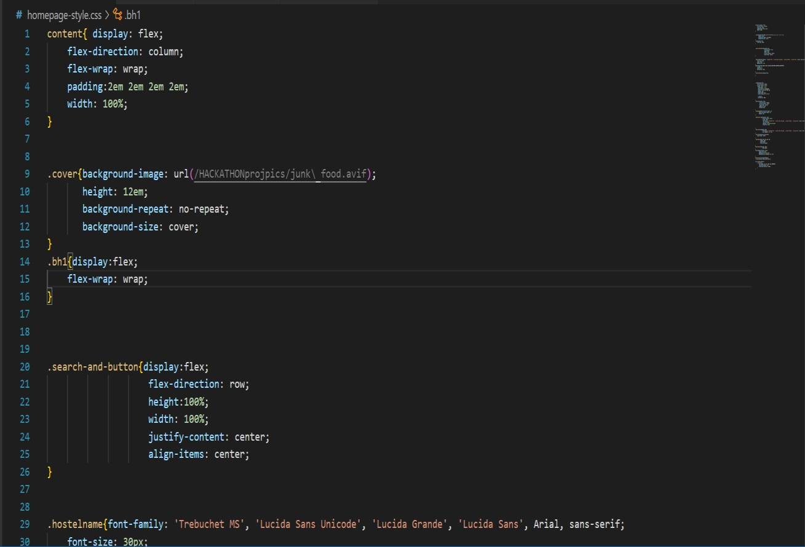

Slide 9
